Slide 1
Modul Pembelajaran [Kode Modul]
[NAMA MODUL]
Page ini diisi oleh Telkom
Pathway | :
Sub Pathway | :
Kompetensi | :
Key Element | :
Level | :
Developer | :
Approval | : | 1. Mgr Learning Development 2. SM School of Dig Platform & Service
Sesuai Dirkom-10
Nama/ NIK/ Bidang
Atau Nama Vendor
Rev. : 00
Created/Last Modified : 10-2021

Slide 2
Modul Pembelajaran | : | React Props
Deskripsi Modul | : | Props adalah tipe obyek untuk mengekspresikan sebuah gaya atau event dalam komponen ReactJS.
Enabling Learning Objective | : | Memahami tentang props, definisi nya, dan penggunaan nya dalam ReactJS.
Daftar Topik | : | Default props State and props
Searching Keyword | : | ReactJS props states object attributes event-handling

Slide 3



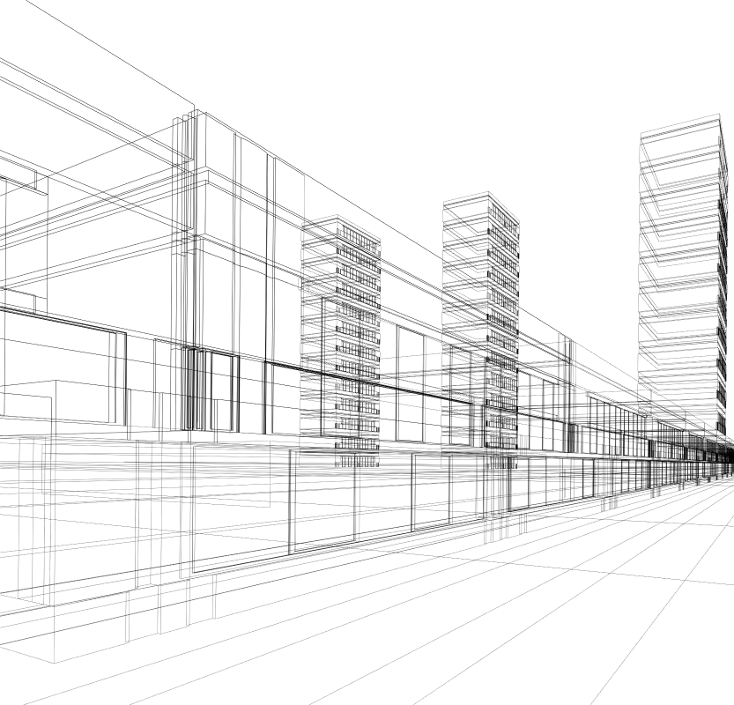
REACTJS
React Props
Calvin Susanto Putra

Slide 4
Table of Contents
Default Props
States and Props

Slide 5
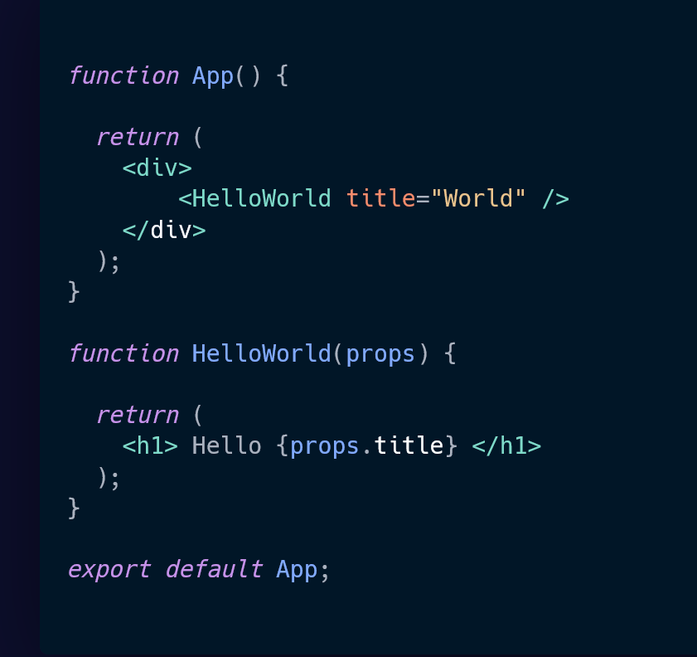
Default Props
Properties, shortened to props, are an object type that allows users to handle events and conduct changes to the codes dynamically
Props are similar to states in that elements could be passed on to another function or component and rendered without implementing additional logic or utility
The primary difference is that props are immutable, wherein they could not be modified or updated further once it is created or rendered
An example of a props used to pass on an element to a component.

Slide 6
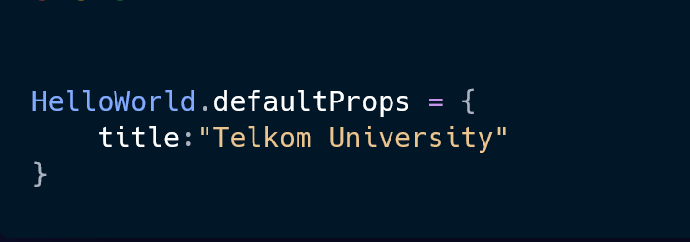
Default Props
Default props denote properties which are kept in the parent component and do not get passed on to any of the child component
The defaultProps method declares the static behaviour of a given prop when passed on to the previous example:

Slide 7

States and Props
Although both states and props are objects that allow for changes in an element, states are mutable, in that it could constantly be updated and changed according to user needs
This allows states to be used in dynamic UI components for single-page applications; periodically fetching and storing data to be rendered on a page
Phuong Anh - ArrowHiTech.com

Slide 8
States and Props
Although both states and props allow for changes in an element, states are mutable, in that it could constantly be updated and changed according to user needs
This allows states to be used in dynamic UI components for single-page applications; periodically fetching and storing data to be rendered on a page
Phuong Anh - ArrowHiTech.com

Slide 9
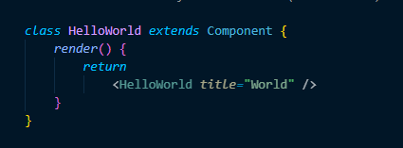
States and Props
The mutability of states influences the output of a component and could be hidden, whilst props are reliant on a preset input
Refer to the figure for a complete example of props being used in a to pass to an element within a React project:

Slide 10
References
https://www.freecodecamp.org/news/how-to-use-props-in-react/
https://www.robinwieruch.de/react-pass-props-to-component/
https://www.w3schools.com/react/react_props.asp
https://dmitripavlutin.com/react-props/
https://www.tutorialspoint.com/reactjs/reactjs_props_overview.htm

Slide 11
REACTJS
React Props
Calvin Susanto Putra

Slide 12
Kelengkapan Modul
Pre & Post Test (minimal 10 soal, pilihan ganda a-d)
Pre Reading
Teaching Notes
Referensi

Slide 13
Assessment – [Pre & Post Test]

Slide 14

Pre-Reading
ReactJS is a Javascript library for building user interfaces. This PDF ebook is a portable offline reference guide for the community, can be printed or synced with your kindle for a better reading experience. It's based on ReactJS version v.16.13.1
This is an excellent reference format for ReactJS beginners, is not a tutorial just the official documentation for your reference

Slide 15
TEACHING NOTES*
Lesson/Topics
Case Study
Clips
Games
Others : . . . . . . . . . . . .
OBJECTIVES
PERSIAPAN
Memahami tentang props, definisi nya, dan penggunaan nya dalam ReactJS.
Offline: Laptop
Online: Link Zoom
OVERVIEW
DIRECTION
Props adalah tipe obyek untuk mengekspresikan sebuah gaya atau event dalam komponen ReactJS.
Menjelaskan definisi dan penggunaan props untuk mengubah elemen dalam React
Demontrasikan pemakaian props untuk mengasih nilai baru ke dalam elemen lain
Menjelaskan perbedaan diantara props dan states
Mengatur dan mengelola arah dan jalan-nya diskusi;
Memberikan contoh-contoh, kasus dan ilustrasi;
Memberikan apresiasi dalam tanya jawab;
Memberikan debrief atau insight/pesan dari kegiatan;
Memberikan dan menyampaikan kesimpulan dan di tiap sesi atau di akhir sesi
PERALATAN YANG DIBUTUHAN
Offline : Laptop
Online: Link Zoom
*Catatan : jumlah halaman teaching Note dapat ditambah seauai kebutuhan

Slide 16
TEACHING NOTES 2/2*
DIRECTION
Section (slide/clip/case/etc) | Activities (Hal apa yang akan dilakukan untuk setiap section-nya) | Description (hal-hal spesifik yang harus dilakukan, misal : penjelasan dan atau penekanan materi, pengelolaan arah dan jalannya diskusi, wrap up/insight atau debrief, etc)
5-6 | Presentasi, Diskusi | Menjelaskan definisi dan penggunaan props untuk memgubah elemen dalam React
7-9 | Presentasi, Diskusi, Case Study | Menjelaskan perbedaan props dan states dalam React

